Slide 1


03 entropy, KL divergence,
William Trimble
Spring 2023

Slide 2
Office hours
WT Wednesday 12:30-2
WT Friday 12:30-2:0-0

Slide 3
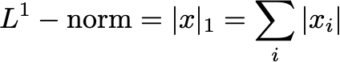
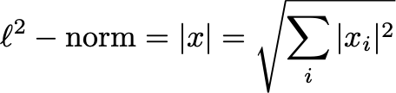
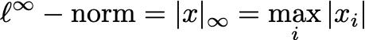
The norm definitions
“norms” always have same units as x!

Slide 4
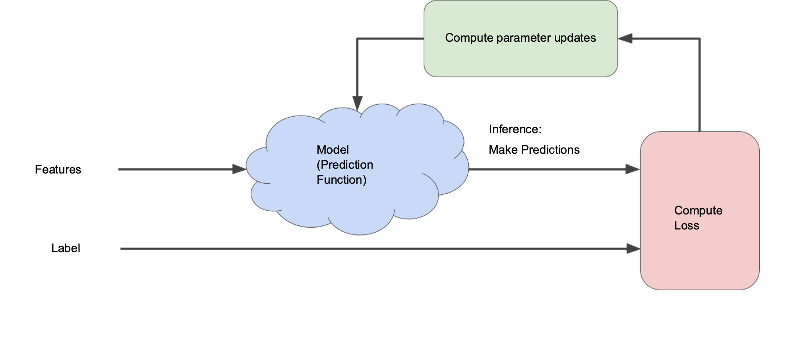
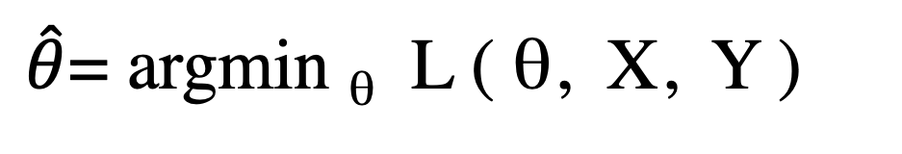
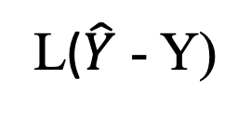

Fairy dust picture of optimization
$\hat{θ}$= argmin _{θ} L ( θ, X, Y )
Loss
Optimizer
parameters θ
$$\hat{Y}$$
X
Model
Loss
func.
features
predictions
Y
L($\hat{Y}$ - Y)
labels

Slide 5
Inferring parameters
θ: value of model parameter
Y: training data
P( θ | Y ) = P(Y|θ) P(θ) / P(Y)
Distribution
to help me
find the
parameter value
posterior
This is the
likelihood
likelihood
Y
θ
Prior
distribution
for parameter
prior
Doesn’t
matter for
us
evidence
θ∩Y

Slide 6
Inferring parameters
θ: value of model parameter
Y: training data
log P(θ | Y ) = log P(Y| θ) + log P(θ)
log parameter distribution
The log likelihood
Prior distribution
on the parameter
log prior
log posterior
log likelihood

Slide 7
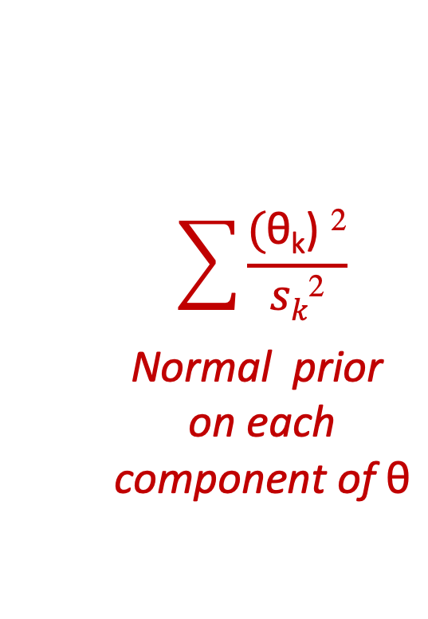
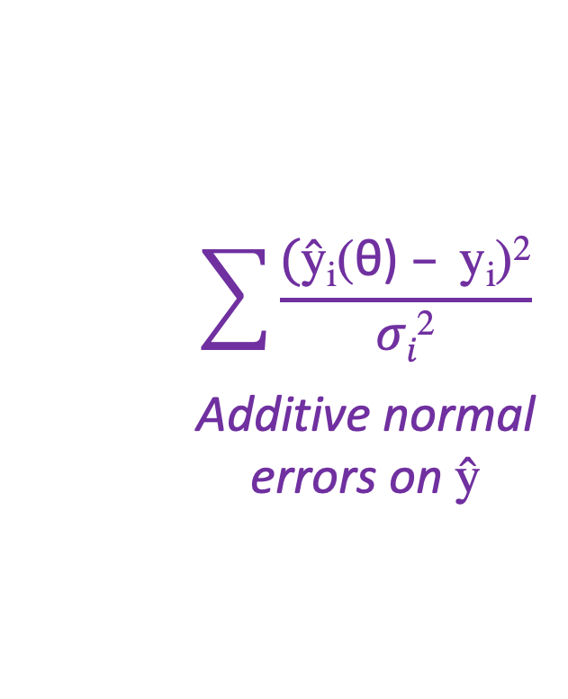
Inferring parameters
θ: value of model parameter
Y: training data
log P( θ | Y ) = log P(Y| θ) + log P(θ)
$$\sum{\frac{\text{(}\text{ŷ}\text{i}\text{(}\text{θ}\text{)} – \text{y}\text{i}\text{)}\text{2}}{σi\text{2}}}$$
Additive normal
errors on $\text{ŷ}$
$$\sum{\frac{\text{(}\text{θ}\text{k}\text{)} \text{2}}{sk\text{2}}}$$
Normal prior
on each
component of $\text{θ}$
L ( θ | Y ) =
log prior
+
log posterior
log likelihood

Slide 8

Dice problem
Suppose I have two six-sided dice:
A: 1 2 3 4 5 6
B: 1 2 3 4 5 1
P(O|A) =$\frac{1}{6}\text{, }\frac{1}{6}, \frac{1}{6}$ , $\frac{1}{6}$ , $\frac{1}{6}$ , $\frac{1}{6}$
P(O|B) = $\frac{1}{3} , \frac{1}{6}$ $, \frac{1}{6}$ , $\frac{1}{6}$ , $\frac{1}{6}$, 0

Slide 9

Dice problem
Suppose I have two six-sided dice:
A: 1 2 3 4 5 6
B: 1 2 3 4 5 1
P(O|A) =$\frac{1}{6}\text{, }\frac{1}{6}, \frac{1}{6}$ , $\frac{1}{6}$ , $\frac{1}{6}$ , $\frac{1}{6}$
P(O|B) = $\frac{1}{3} , \frac{1}{6}$ $, \frac{1}{6}$ , $\frac{1}{6}$ , $\frac{1}{6}$, 0
Imagine the rolls of the dice as symptoms of a denial of service attack, sypmtoms of cancer, and the identity of the die (A or B) as the underlying state of nature to be estimated.

Slide 10

Dice problem
Suppose I have two six-sided dice:
A: 1 2 3 4 5 6
B: 1 2 3 4 5 1
P(O|A) =$\frac{1}{6}\text{, }\frac{1}{6}, \frac{1}{6}$ , $\frac{1}{6}$ , $\frac{1}{6}$ , $\frac{1}{6}$
P(O|B) = $\frac{1}{3} , \frac{1}{6}$ $, \frac{1}{6}$ , $\frac{1}{6}$ , $\frac{1}{6}$, 0
The first time I see a six, the game is over.

Slide 11
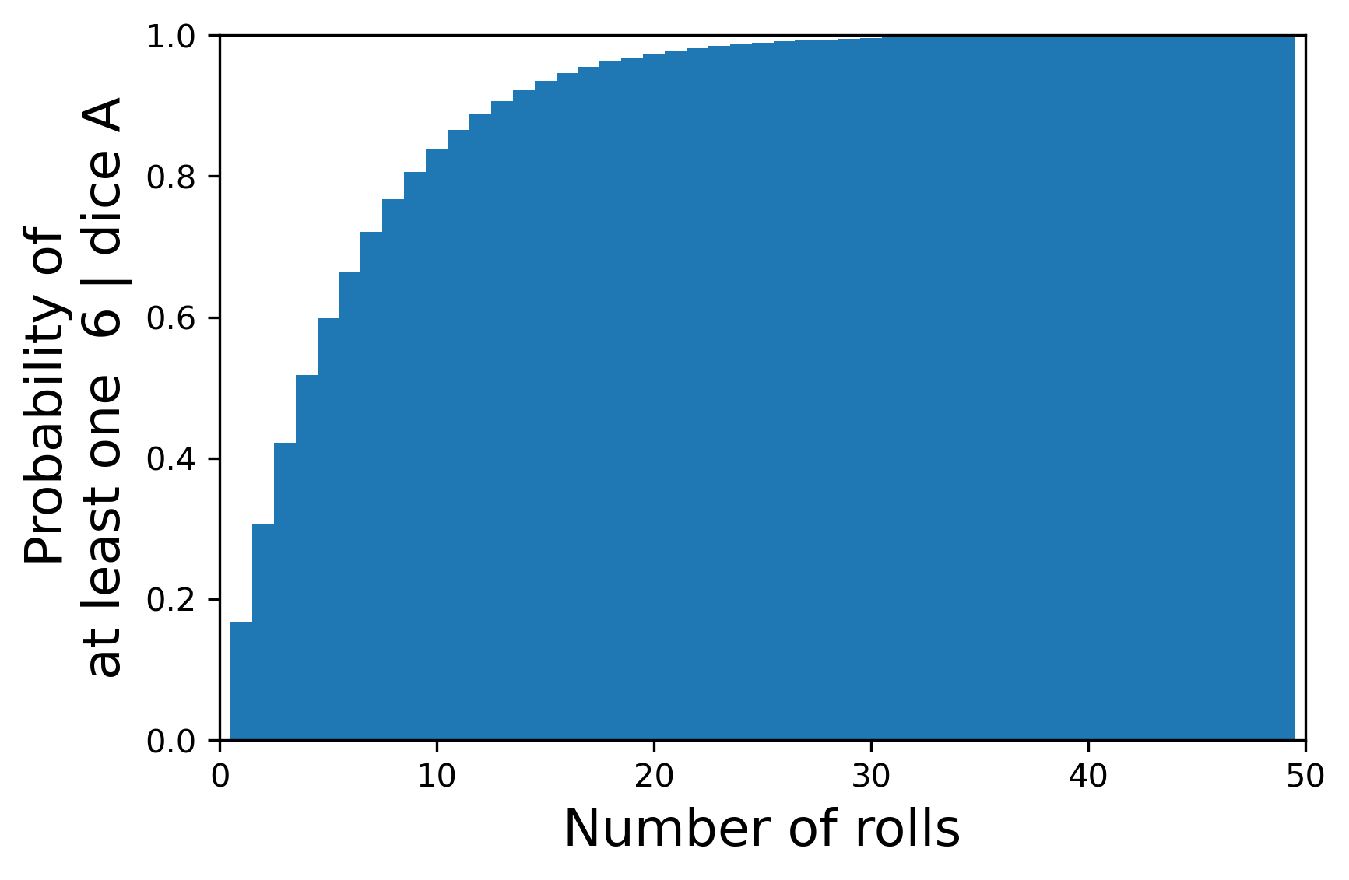
Dice problem
Geometric (k , p=1/6)
Suppose I have two six-sided dice:
A: 1 2 3 4 5 6
B: 1 2 3 4 5 1
P(O|A) =$\frac{1}{6}\text{, }\frac{1}{6}, \frac{1}{6}$ , $\frac{1}{6}$ , $\frac{1}{6}$ , $\frac{1}{6}$
P(O|B) = $\frac{1}{3} , \frac{1}{6}$ $, \frac{1}{6}$ , $\frac{1}{6}$ , $\frac{1}{6}$, 0

Slide 12
Dice problem
Suppose I have two six-sided dice:
A: 1 2 3 4 5 6
B: 1 2 3 4 5 1
P(O|A) =$\frac{1}{6}\text{, }\frac{1}{6}, \frac{1}{6}$ , $\frac{1}{6}$ , $\frac{1}{6}$ , $\frac{1}{6}$
P(O|B) = $\frac{1}{3} , \frac{1}{6}$ $, \frac{1}{6}$ , $\frac{1}{6}$ , $\frac{1}{6}$, 0
P( A | roll ) = P(roll|A) P(A) / P(roll)
P( B | roll ) = P(roll|B) P(B) / P(roll)
Suggestion: Why don’t I keep track of the ratio of the probability of A to the probability of B?

Slide 13
Dice problem
Suppose I have two six-sided dice:
A: 1 2 3 4 5 6
B: 1 2 3 4 5 1
P(O|A) =$\frac{1}{6}\text{, }\frac{1}{6}, \frac{1}{6}$ , $\frac{1}{6}$ , $\frac{1}{6}$ , $\frac{1}{6}$
P(O|B) = $\frac{1}{3} , \frac{1}{6}$ $, \frac{1}{6}$ , $\frac{1}{6}$ , $\frac{1}{6}$, 0
P( A | roll ) = P(roll|A) P(A) / P(roll)
P( B | roll ) = P(roll|B) P(B) / P(roll)
Suggestion: Why don’t I keep track of the ratio of the probability of A to the probability of B?
Consequence: I’m going to need a lookup table for P(A|R ) / P(B|R) for all the relevant values of R.

Slide 14
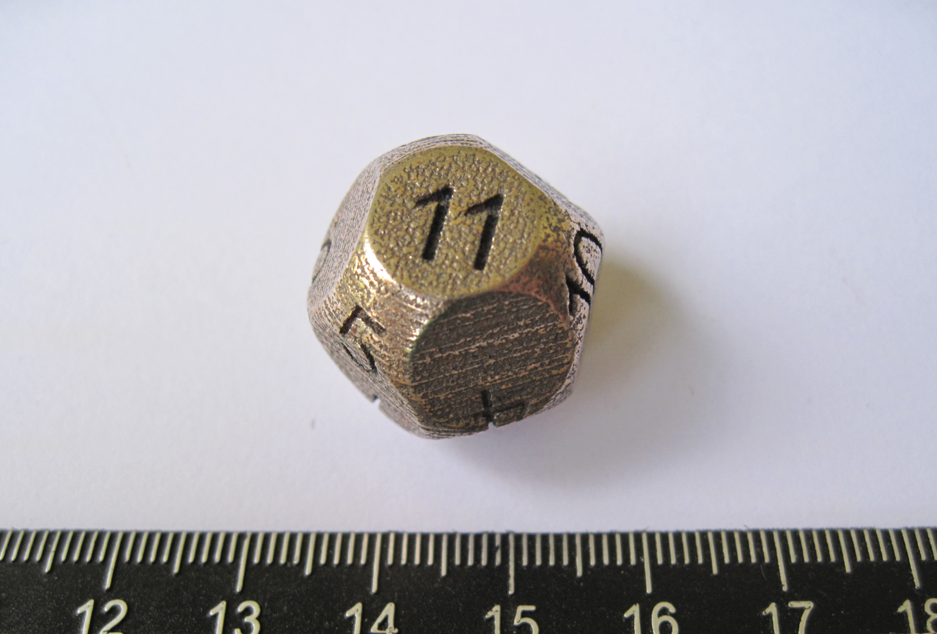
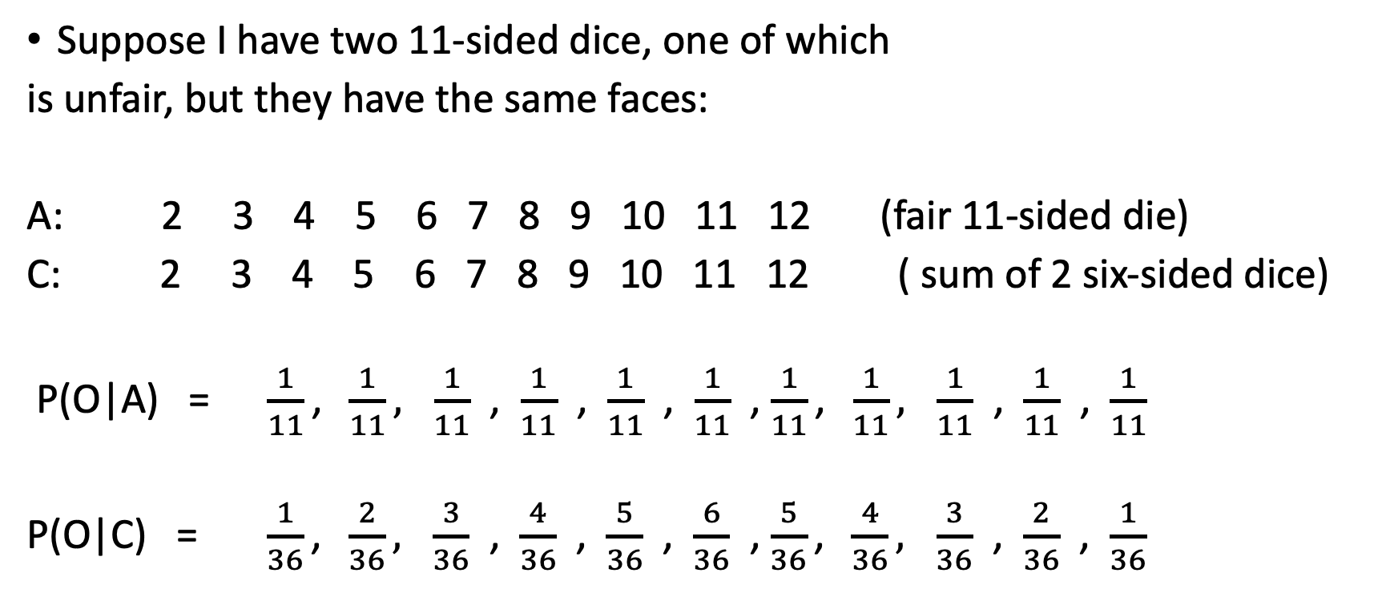
Dice problem
Suppose I have two 11-sided dice, one of which
is unfair, but they have the same faces:
A: 2 3 4 5 6 7 8 9 10 11 12 (fair 11-sided die)
C: 2 3 4 5 6 7 8 9 10 11 12 ( sum of 2 six-sided dice)
P(O|A) =$\frac{1}{11}\text{, }\frac{1}{11}, \frac{1}{11}$ , $\frac{1}{11}$ , $\frac{1}{11}$ , $\frac{1}{11}$ , $\frac{1}{11}\text{, }\frac{1}{11}, \frac{1}{11}$ , $\frac{1}{11}$ , $\frac{1}{11}$
P(O|C) = $\frac{1}{36}\text{, }\frac{2}{36}, \frac{3}{36}$ , $\frac{4}{36}$ , $\frac{5}{36}$ , $\frac{6}{36}$ , $\frac{5}{36}\text{, }\frac{4}{36}, \frac{3}{36}$ , $\frac{2}{36}$ , $\frac{1}{36}$

Slide 15
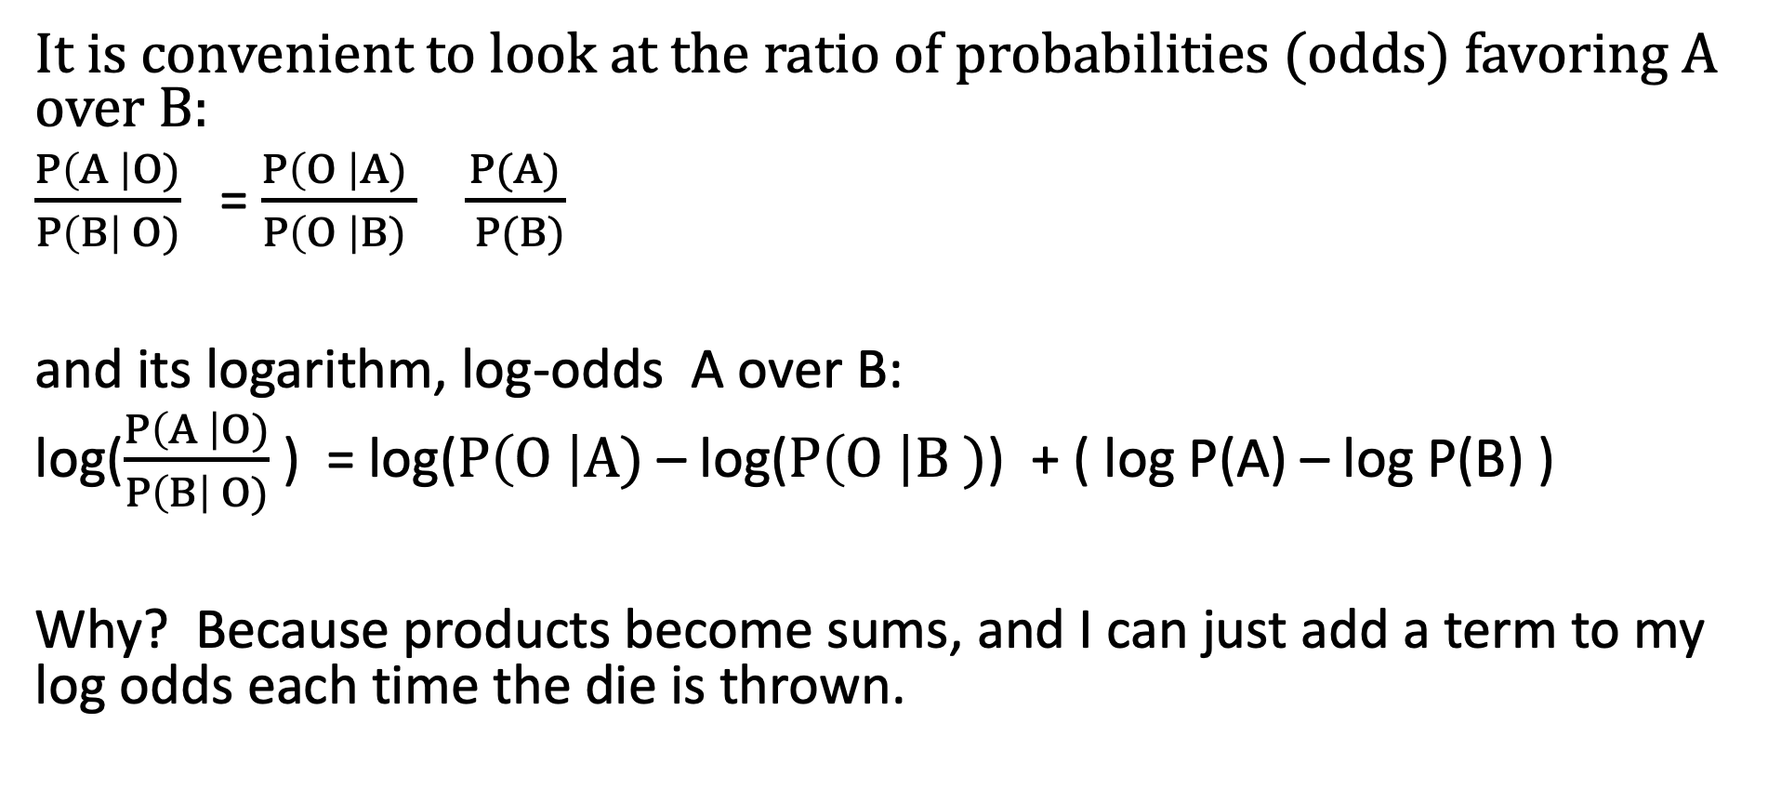
So let’s calculate the odds ratio A:B
It is convenient to look at the ratio of probabilities (odds) favoring A over B:
$\frac{P\left(A \right|O)}{P\left(B\right| O)}$ = $\frac{P\left(O \right|A) }{P\left(O \right|B) } \frac{P(A)}{ P(B)}$
and its logarithm, log-odds A over B:
log($\frac{P\left(A \right|O)}{P\left(B\right| O)}$) = log($P\left(O \right|A)$ – log($P\left(O \right|B )$) + ( log P(A) – log P(B) )
Why? Because products become sums, and I can just add a term to my log odds each time the die is thrown.

Slide 16
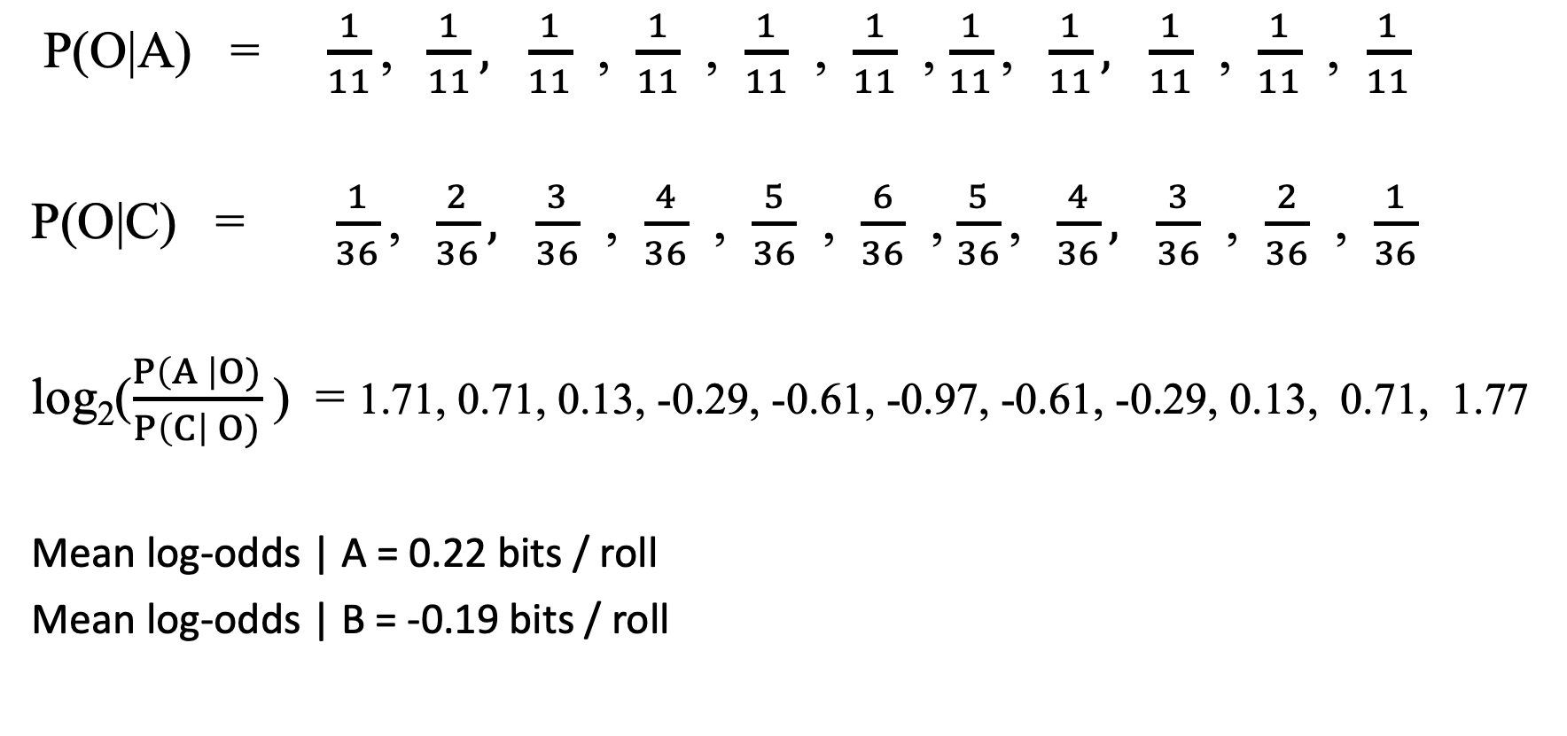
How long will it take?
P(O|A) =$\frac{1}{11}\text{, }\frac{1}{11}, \frac{1}{11}$ , $\frac{1}{11}$ , $\frac{1}{11}$ , $\frac{1}{11}$ , $\frac{1}{11}\text{, }\frac{1}{11}, \frac{1}{11}$ , $\frac{1}{11}$ , $\frac{1}{11}$
P(O|C) = $\frac{1}{36}\text{, }\frac{2}{36}, \frac{3}{36}$ , $\frac{4}{36}$ , $\frac{5}{36}$ , $\frac{6}{36}$ , $\frac{5}{36}\text{, }\frac{4}{36}, \frac{3}{36}$ , $\frac{2}{36}$ , $\frac{1}{36}$
log₂($\frac{P\left(A \right|O)}{P\left(C\right| O)}$) = 1.71, 0.71, 0.13, -0.29, -0.61, -0.97, -0.61, -0.29, 0.13, 0.71, 1.77
Mean log-odds | A = 0.22 bits / roll
Mean log-odds | B = -0.19 bits / roll
log₂ 99 = 6.63 bits (threshold 99:1)

Slide 17
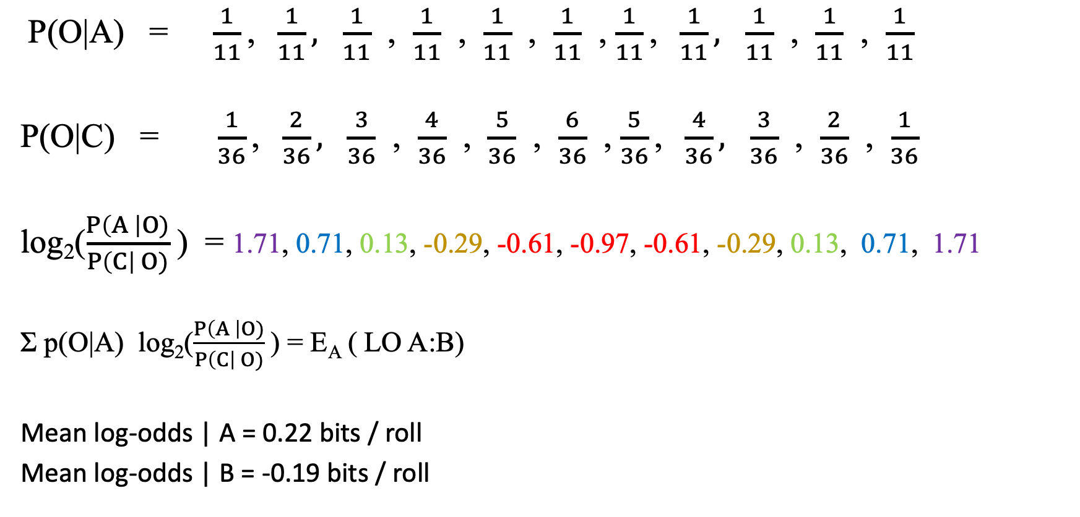
How long will it take?
P(O|A) =$\frac{1}{11}\text{, }\frac{1}{11}, \frac{1}{11}$ , $\frac{1}{11}$ , $\frac{1}{11}$ , $\frac{1}{11}$ , $\frac{1}{11}\text{, }\frac{1}{11}, \frac{1}{11}$ , $\frac{1}{11}$ , $\frac{1}{11}$
P(O|C) = $\frac{1}{36}\text{, }\frac{2}{36}, \frac{3}{36}$ , $\frac{4}{36}$ , $\frac{5}{36}$ , $\frac{6}{36}$ , $\frac{5}{36}\text{, }\frac{4}{36}, \frac{3}{36}$ , $\frac{2}{36}$ , $\frac{1}{36}$
log₂($\frac{P\left(A \right|O)}{P\left(C\right| O)}$) = 1.71, 0.71, 0.13, -0.29, -0.61, -0.97, -0.61, -0.29, 0.13, 0.71, 1.71
Σ p(O|A) log₂($\frac{P\left(A \right|O)}{P\left(C\right| O)}$) = E_{A} ( LO A:B)
Mean log-odds | A = 0.22 bits / roll
Mean log-odds | B = -0.19 bits / roll
log₂ 99 = 6.63 bits (threshold 99:1)
6.63 bits / 0.22 bits / roll = 30.2 rolls |A
6.63 bits / 0.19 bits / roll = 35.8 rolls |B

Slide 18
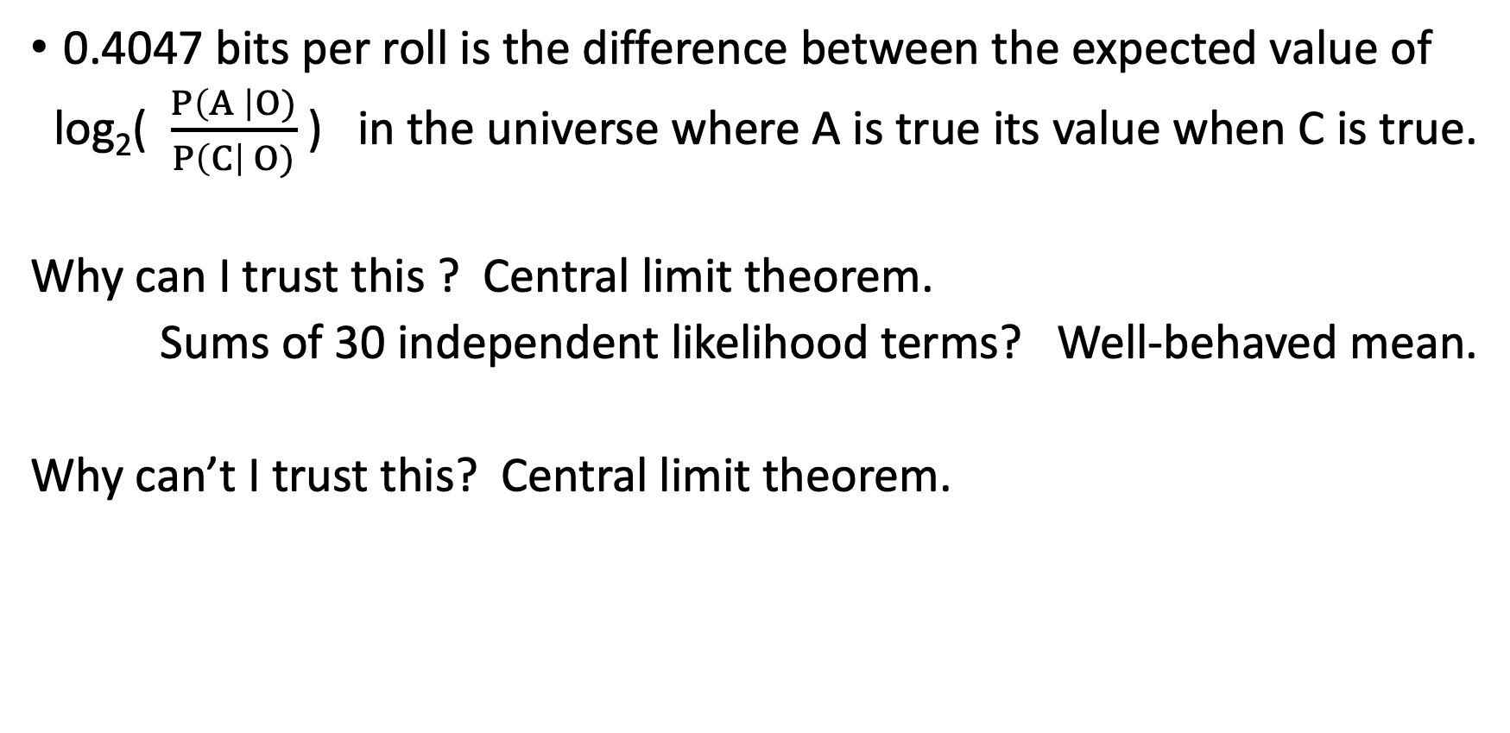
Wait, what assumptions did I make here?
0.4047 bits per roll is the difference between the expected value of
log₂( $\frac{P\left(A \right|O)}{P\left(C\right| O)}$) in the universe where A is true its value when C is true.
Why can I trust this ? Central limit theorem.
Sums of 30 independent likelihood terms? Well-behaved mean.
Why can’t I trust this? Central limit theorem.

Slide 19
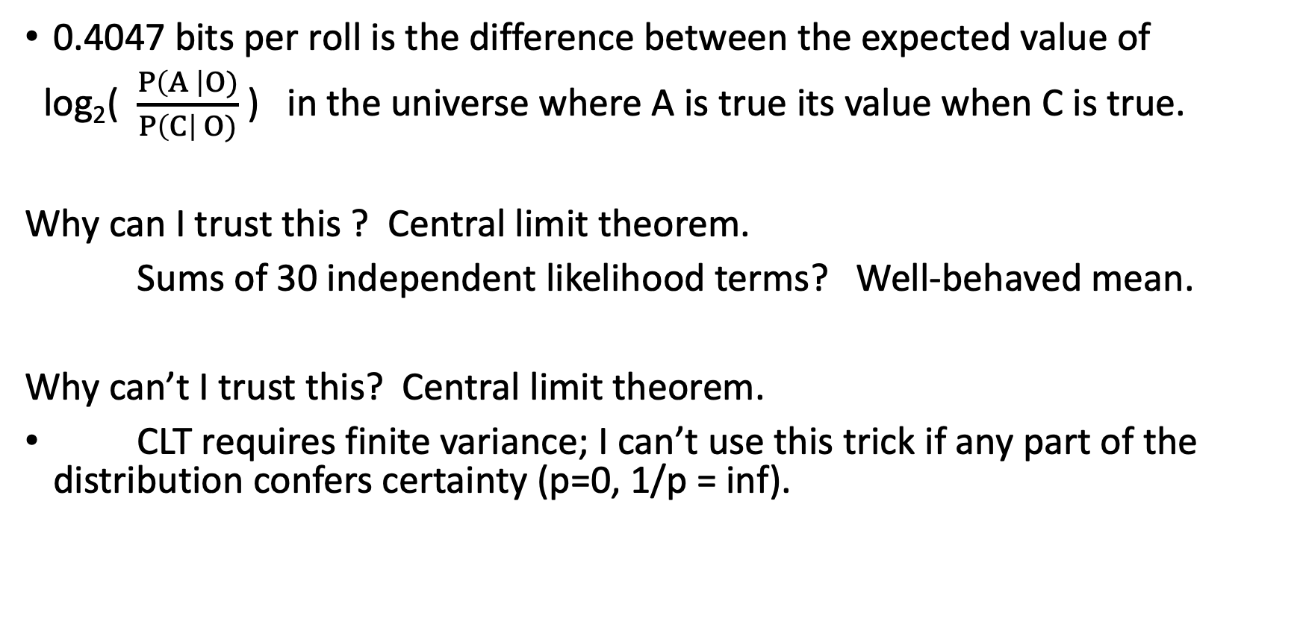
Wait, what assumptions did I make here?
0.4047 bits per roll is the difference between the expected value of
log₂( $\frac{P\left(A \right|O)}{P\left(C\right| O)}$) in the universe where A is true its value when C is true.
Why can I trust this ? Central limit theorem.
Sums of 30 independent likelihood terms? Well-behaved mean.
Why can’t I trust this? Central limit theorem.
CLT requires finite variance; I can’t use this trick if any part of the distribution confers certainty (p=0, 1/p = inf).

Slide 20
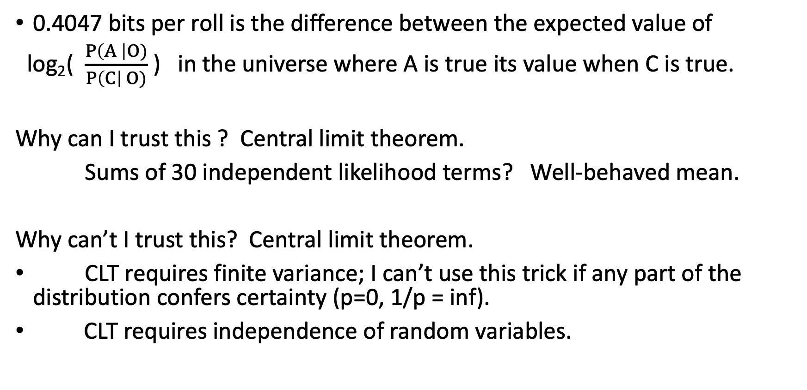
Wait, what assumptions did I make here?
0.4047 bits per roll is the difference between the expected value of
log₂( $\frac{P\left(A \right|O)}{P\left(C\right| O)}$) in the universe where A is true its value when C is true.
Why can I trust this ? Central limit theorem.
Sums of 30 independent likelihood terms? Well-behaved mean.
Why can’t I trust this? Central limit theorem.
CLT requires finite variance; I can’t use this trick if any part of the distribution confers certainty (p=0, 1/p = inf).
CLT requires independence of random variables.

Slide 21
Dice problem
Geometric (k , p=1/6)
Suppose I have two six-sided dice:
A: 1 2 3 4 5 6
B: 1 2 3 4 5 1
P(O|A) =$\frac{1}{6}\text{, }\frac{1}{6}, \frac{1}{6}$ , $\frac{1}{6}$ , $\frac{1}{6}$ , $\frac{1}{6}$
P(O|B) = $\frac{1}{3} , \frac{1}{6}$ $, \frac{1}{6}$ , $\frac{1}{6}$ , $\frac{1}{6}$, 0

Slide 22
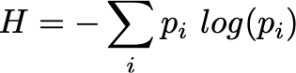
Entropy
Entropy is a property of a probability distribution (or of an element within a probability distribution, like an outcome) that describes how concentrated the distribution is.

Slide 23
Entropy
It has been constructed to have some nice properties (entropy of independent events is additive) and is, up to a multiplicative constant (which is the same as choosing the base of logarithm) the unique measure for which products are sums.

Slide 24
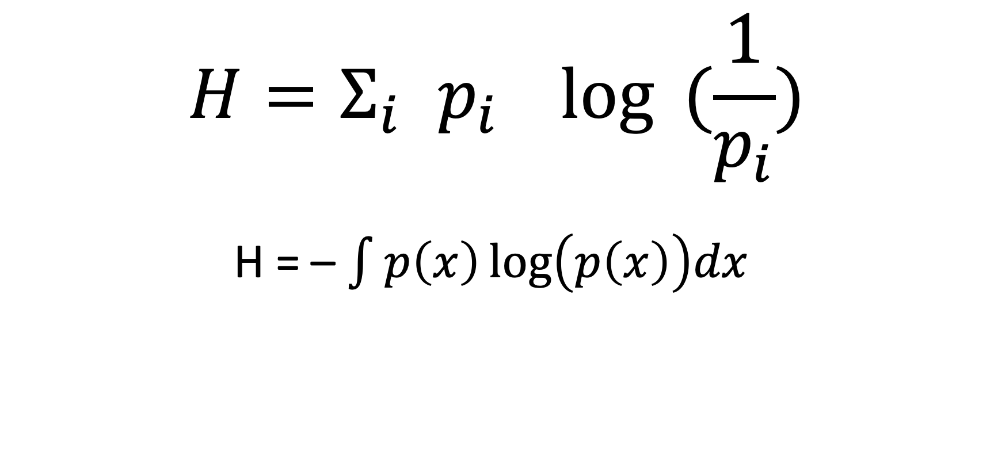
Entropy – discrete formulation
Expected value of the –log probability
$$H=Σ_{i }p_{i}\log{ (\frac{1}{p_{i}})}$$
H = – $\int{p\left(x\right)\log\left(p\left(x\right)\right)dx }$

Slide 25
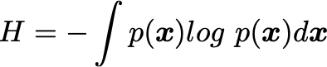
Entropy – continuous formulation
Expected value of the –log probability

Slide 26
Entropy – parts of the definition
Expected value – weighted by probability
log – entropies of independent events additive
negative – probabilities are all < 1; logs of all these probabilities are < 0; convention makes low-probabilities high entropy and high probabilities low-entropy.
letter freq p -log(p)
a 0.0575 4.13
b 0.0128 6.28
c 0.0263 5.25
j 0.0006 10.70
d 0.0285 5.13
e 0.0913 3.45

Slide 27
Properties of entropy
If all of the probability is in one outcome, H = 0
Bernoulli distribution: entropy is maximum at p=0.5
Uniform categorical distribution {1/n, 1/n … 1/n} has entropy log n
Watch out for reporting entropy; logarithms have “units” that communicate the base of the log. log10 “ban” log 2 “bits” natural log “nats” Antilog entropy (sometimes called “perplexity”) doesn’t have that problem, since it’s a unitless number.
Tool to characterize and compare distributions; tool for use in loss function.

Slide 28
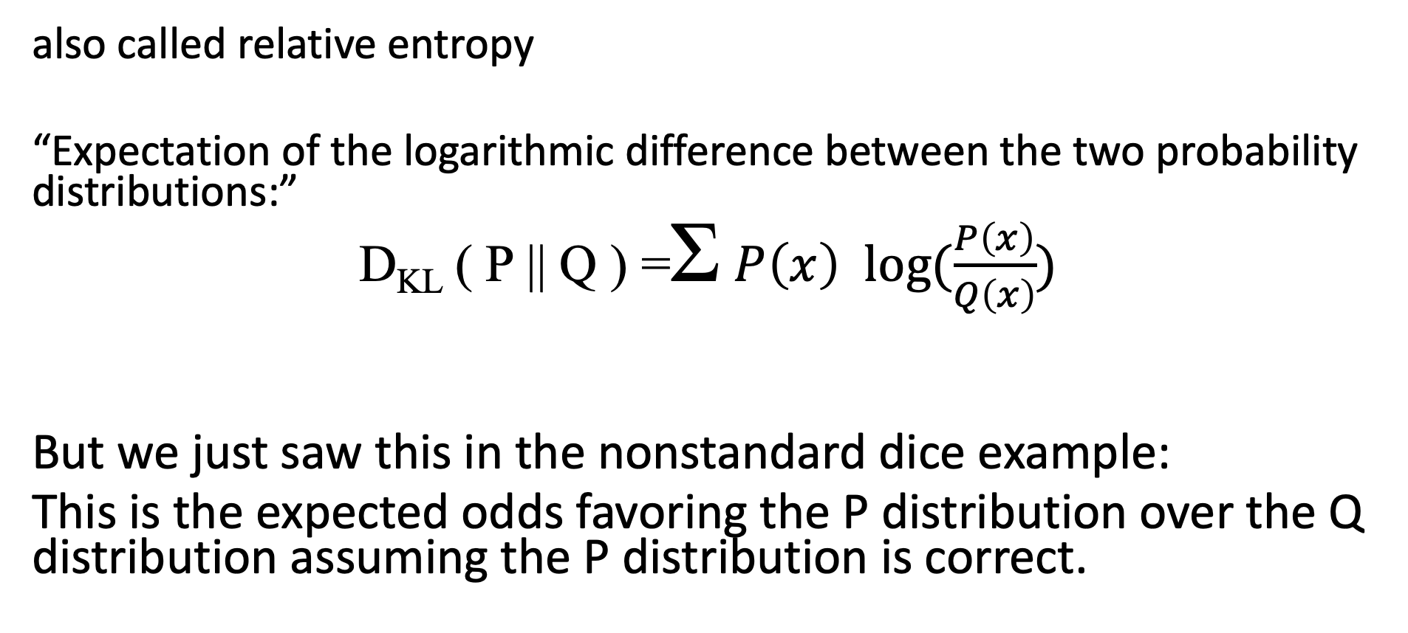
Kullback-Leibler divergence
also called relative entropy
“Expectation of the logarithmic difference between the two probability distributions:”
D_{KL} ( P || Q ) =Σ $P\left(x\right) log⁡(\frac{P\left(x\right)}{Q\left(x\right)})$
But we just saw this in the nonstandard dice example:
This is the expected odds favoring the P distribution over the Q distribution assuming the P distribution is correct.

Slide 29
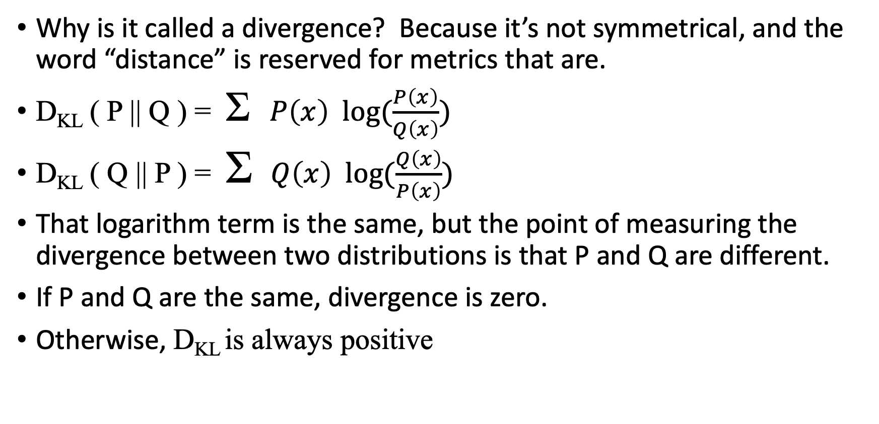
Properties of the Kullback-Liebler divergence
Why is it called a divergence? Because it’s not symmetrical, and the word “distance” is reserved for metrics that are.
D_{KL} ( P || Q ) = Σ$P\left(x\right) log⁡(\frac{P\left(x\right)}{Q\left(x\right)})$
D_{KL} ( Q || P ) = Σ $Q\left(x\right) log⁡(\frac{Q\left(x\right)}{P\left(x\right)})$
That logarithm term is the same, but the point of measuring the divergence between two distributions is that P and Q are different.
If P and Q are the same, divergence is zero.
Otherwise, D_{KL} is always positive

Slide 30
So about that K-L divergence asymmetry…
But we saw an asymmetry with the dice:
There was different qualitative behavior between the two true states of the dice:
The die with only 5 different sides causes odds to accrue slowly
The six-sided die will stumble into infinite odds in favor after an average of 6 rolls.
Doesn’t handle 0 probability elegantly; the infinite negative logarithm makes the expected value infinite, which is inconvenient.
There is a symmetrized version that satisfies the triangle inequality, goes by the name Jensen-Shannon divergence if you need it. It imagines an equal mixture model of P and Q.

